Slide 1

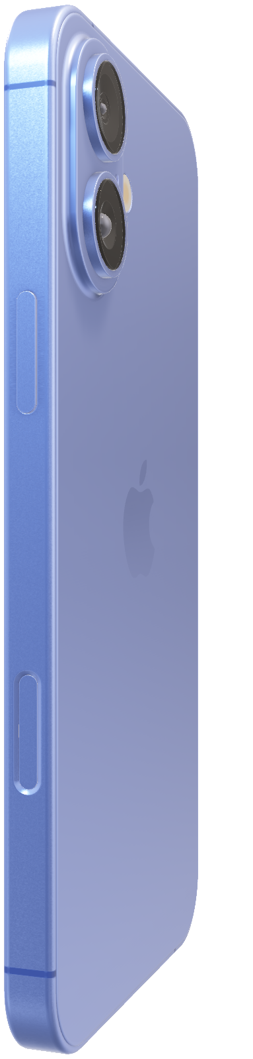
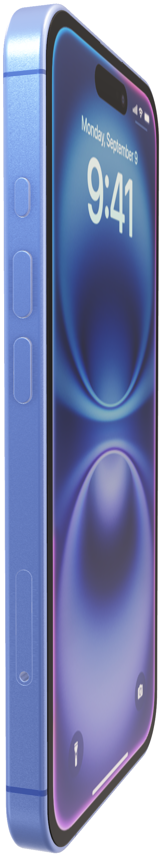
iPhone 16
Hello, Apple Intelligence.

Slide 2
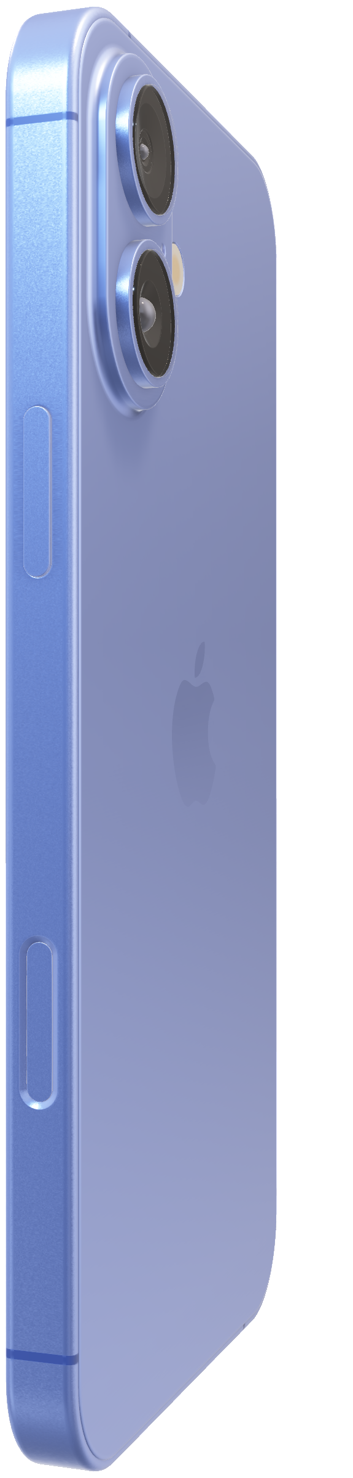
iPhone 16
Hello, Apple Intelligence.

Slide 3
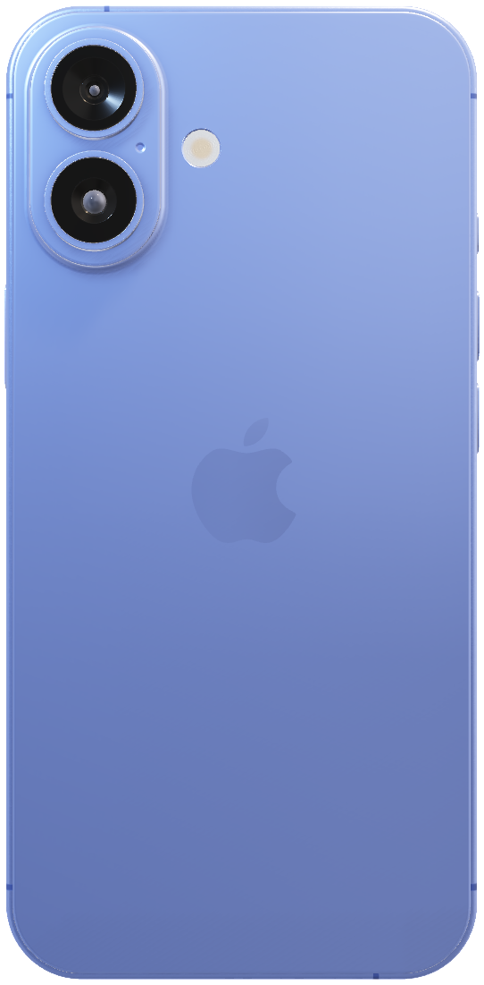
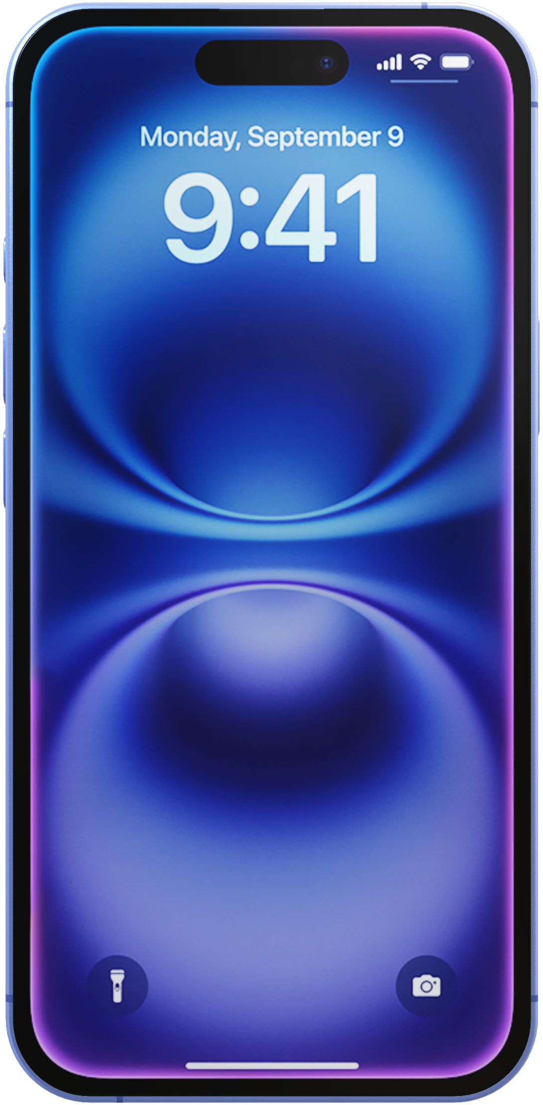
iPhone 16
Hello, Apple Intelligence.
The first iPhone built for Apple Intelligence. Personal, private, powerful.
Apple Intelligence.
AI-opening possibilities.
Coming this fall.

Slide 4
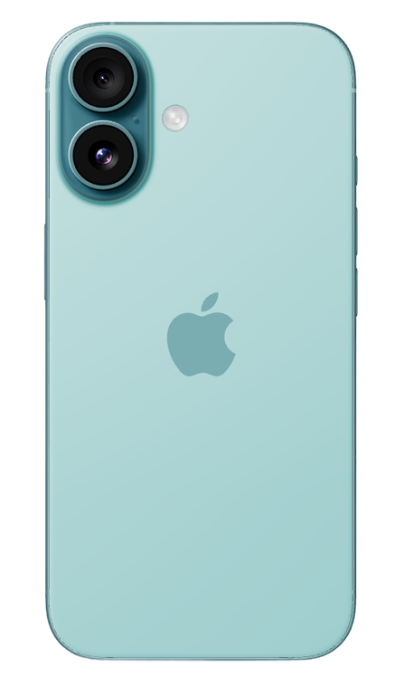
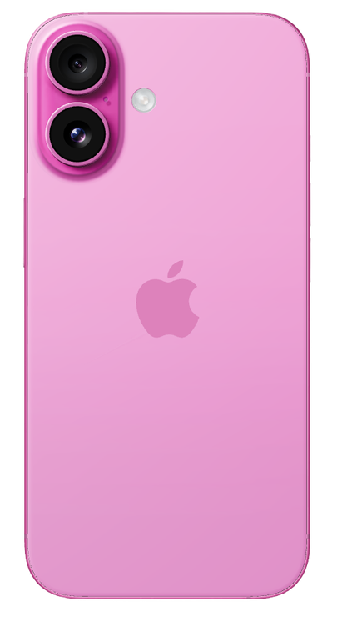
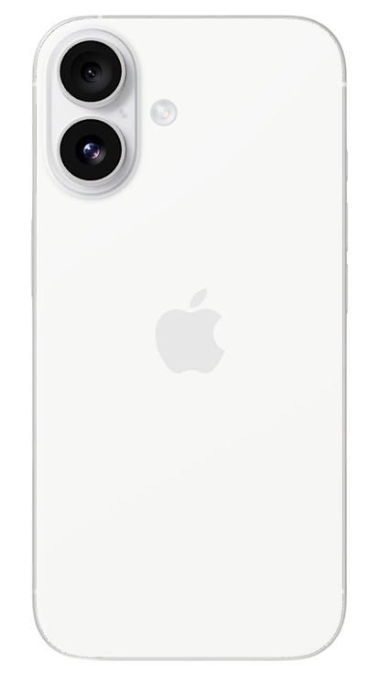
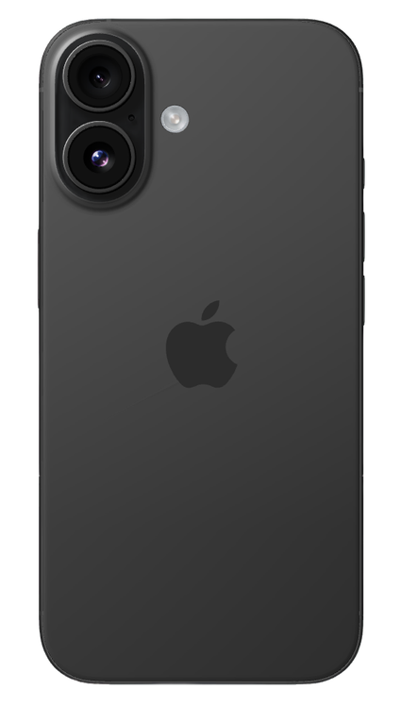
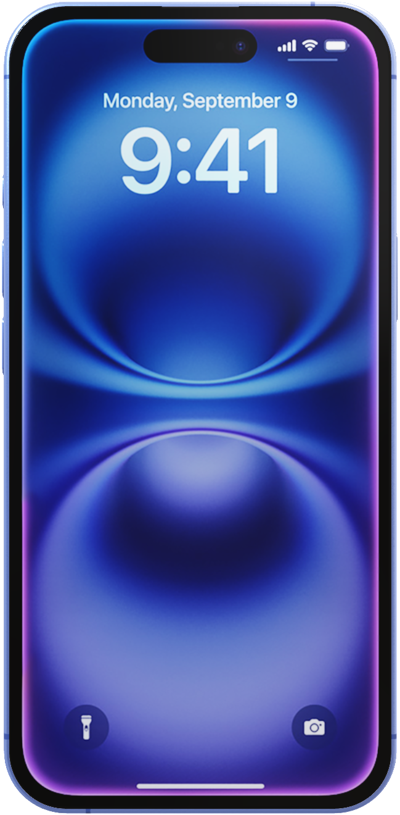
Apple Intelligence.
AI-opening possibilities.
Coming this fall.
The first iPhone built for Apple Intelligence. Personal, private, powerful.

Slide 5

The first iPhone built for Apple Intelligence. Personal, private, powerful.
Strength meets style. iPhone 16 comes in five vibrant colors, from black to ultramarine.

Slide 6
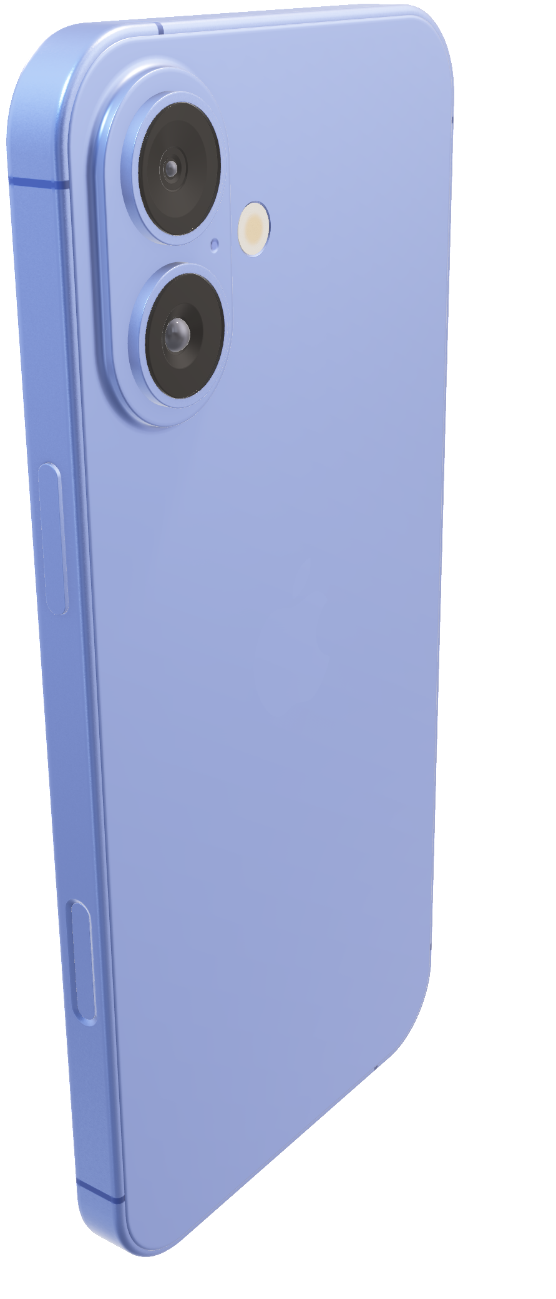
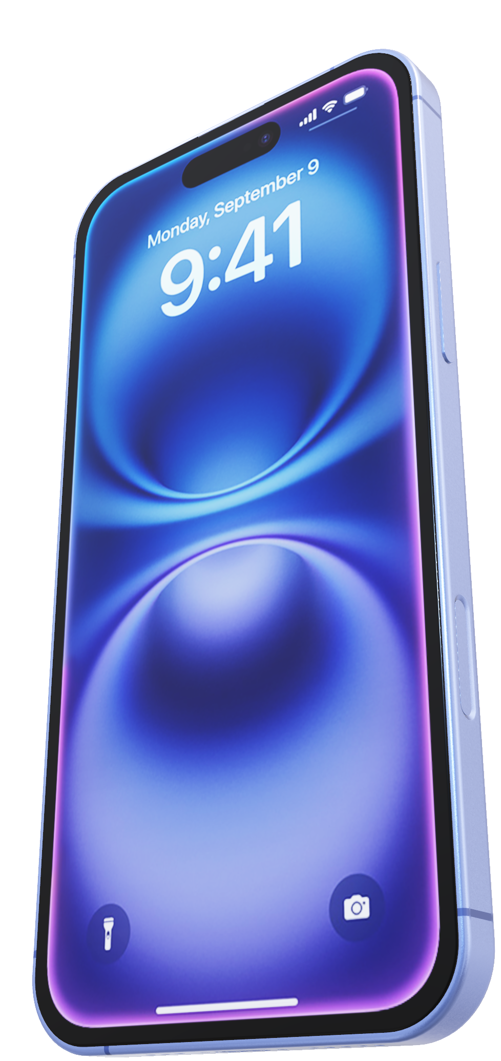
Latest-generation Ceramic Shield.
2x tougher than any smartphone glass.

Slide 7
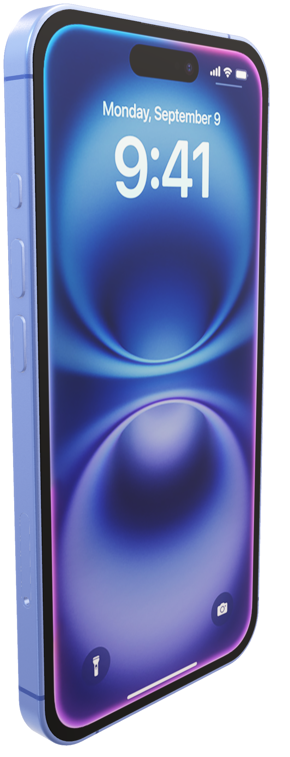
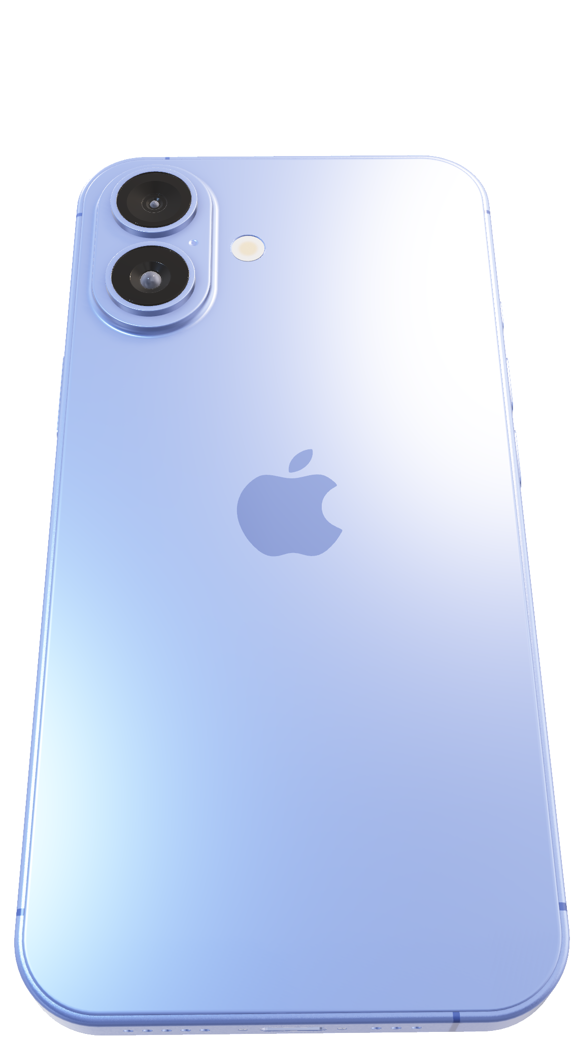
Engineered from beautiful aerospace-grade aluminum.

Slide 8
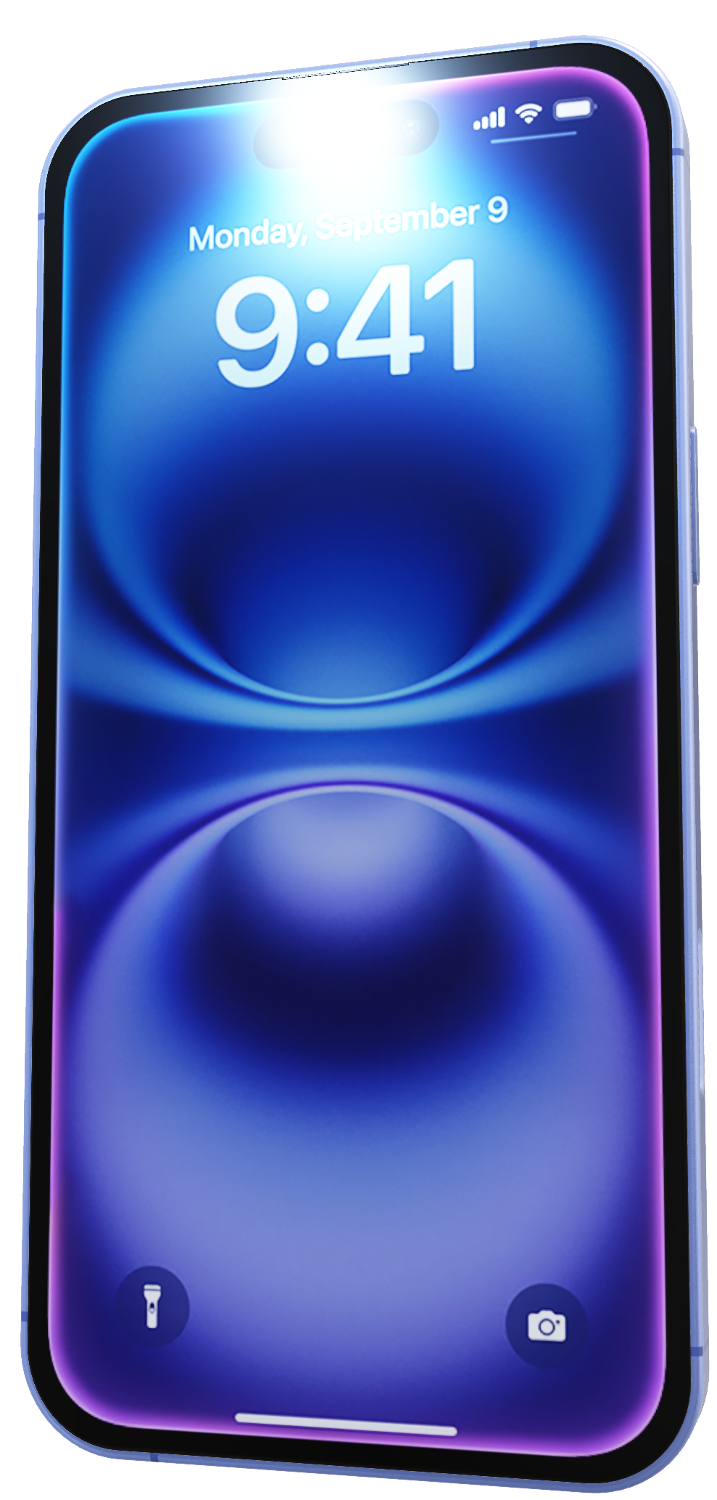
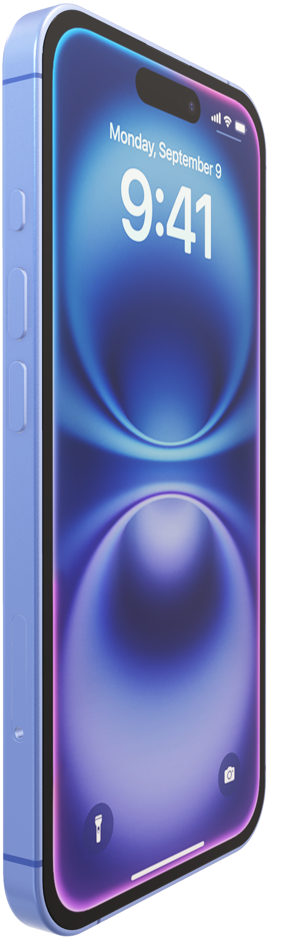
Engineered from beautiful aerospace-grade aluminum.
Action button.
Do more. Wait less.
The Action button on iPhone 16 is a fast track to your favorite feature. Just press and hold to launch the action you want — the flashlight, a voice memo, Silent mode, and more. You can also set up Shortcuts to open an app, run a series of tasks, or change actions depending on the time of day or your location. Or use it to take actions in an app, like setting an alarm or even ordering your favorite coffee drink.

Slide 9
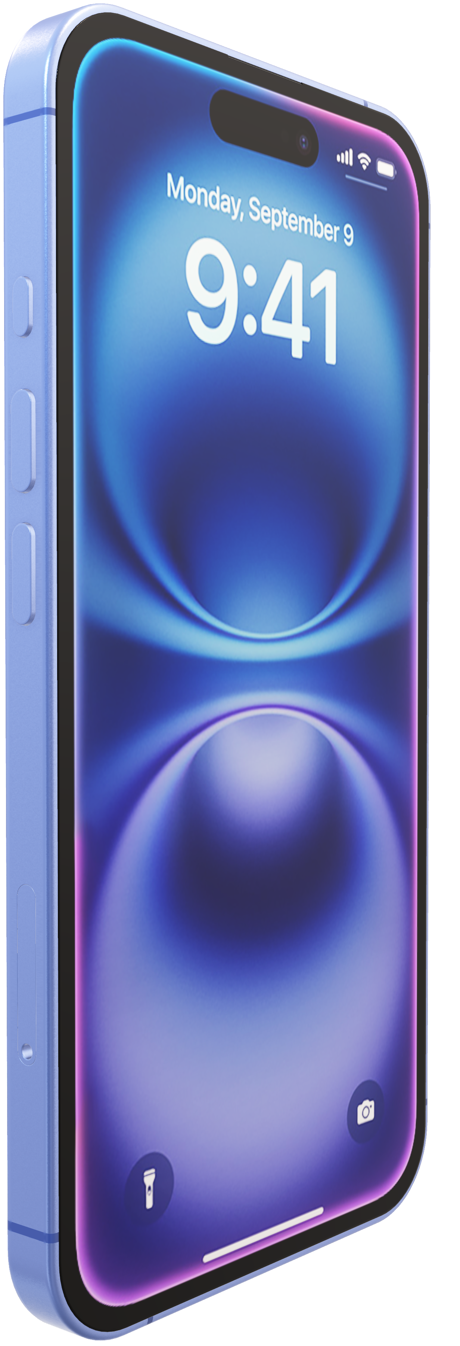
Action button.
Do more. Wait less.
The Action button on iPhone 16 is a fast track to your favorite feature. Just press and hold to launch the action you want — the flashlight, a voice memo, Silent mode, and more. You can also set up Shortcuts to open an app, run a series of tasks, or change actions depending on the time of day or your location. Or use it to take actions in an app, like setting an alarm or even ordering your favorite coffee drink.
Silent mode
Focus
Camera
Flashlight
Voice Memo
Recognize Music
Translate
Magnifier
Controls
Shortcut
Accessibility

Slide 10
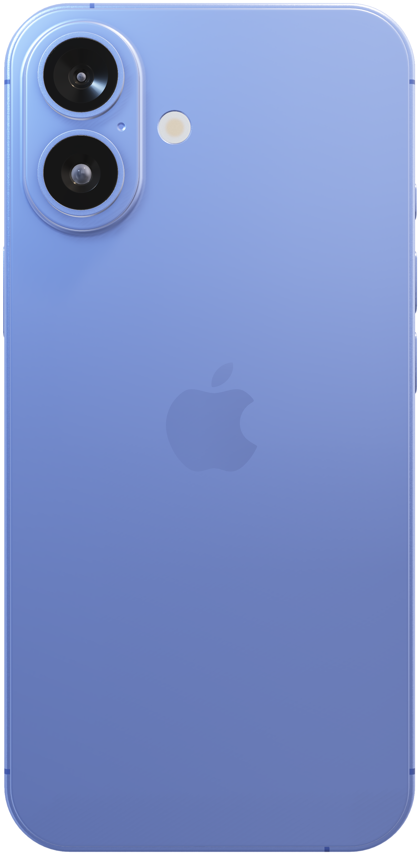
Silent mode
Focus
Camera
Flashlight
Voice Memo
Recognize Music
Translate
Magnifier
New camera system.
Go to great lengths to get the perfect shot.
Controls
Shortcut
Accessibility

